Slide 1

Alarm System
Fedy Haj Ali
Daniela Koreta
Real-Time Embedded System
A.A. 2020-2021

Slide 2
about this project
The project’s aim is to simulate the functioning of an anti-theft alarm system. For this purpose, electronic elements, such as LEDs and buttons, were used to reproduce reality.
Just like a real alarm system, the alarm is triggered when a door/window opening is recorded or when motion is detected. In order to stop the alarm, we need to insert a 4 digits password. A preset password (“0000”) has been chosen to test the application.
To make everything easier and smarter, the possibility to control the alarm from an application has been added in order to have the situation of your home under control at any time.
foto del progetto!

Slide 3
demo
Demo del progetto!
video

Slide 4






tools

Slide 5
hardware components
1x esp32
2x breadboard
4x button
5x led
jumper wires
4x resistor 1kΩ
1x IR receiver sensor
1x HC-SR04 ultrasonic sensor
1x buzzer
1x display LCD 16x2
1x IR remote control

Slide 6
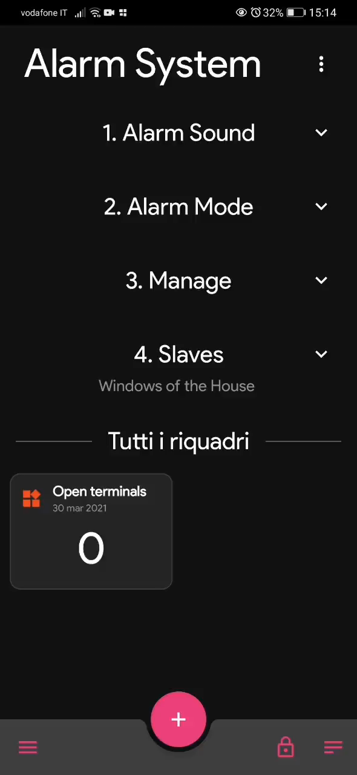
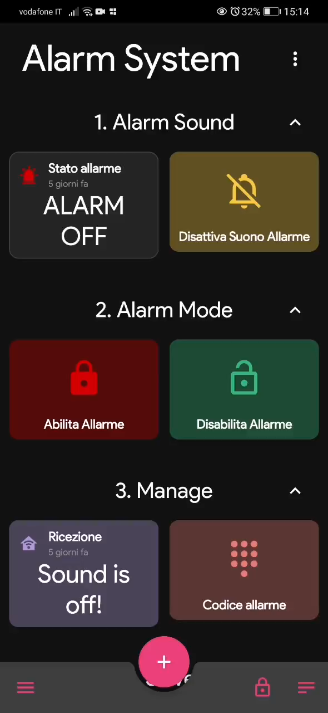
MQTT

Slide 7

MISRA C compliance
CPPCHECK
Cppcheck is an analysis tool for C/C++ code. It provides unique code analysis to detect bugs and focuses on detecting undefined behavior and dangerous coding constructs. Cppcheck is designed to analyze your C/C++ code even if it has non-standard syntax, as is common in for example embedded projects.
misra.py
misra.py is used to verify compliance with MISRA C 2012, a proprietary set of guidelines to avoid questionable code, developed for embedded systems. This standard is proprietary, and open-source tools are not allowed to distribute the Misra rule texts. Therefore, Cppcheck is not allowed to write the rule texts directly. Cppcheck is allowed to distribute the rules and display the id of each violated rule (for example, [c2012-21.3]).
ADDONS
Addons are scripts that analyze Cppcheck dump files to check compatibility with secure coding standards and to locate issues. Cppcheck is distributed with a few addons, one of the supported addons is misra.py.
RUNNING misra.py
Addons could be run through Cppcheck command line utility as follows: cppcheck –addon = misra.py somefile.c
This will launch all Cppcheck checks and additionally calls specific checks provided by selected addon.

Slide 8

before MISRA C
n. rule | rule description | classification | complied
2.7 | There should be no unused parameters in functions | Advisory
7.3 | The lowercase character 'l' shall not be used in a literal suffix | Required
8.11 | When an array with external linkage is declared, its size should be explicitly specified | Advisory
11.6 | A cast shall not be performed between pointer to void and an arithmetic type | Required
12.1 | The precedence of operators within expressions should be made explicit | Advisory
14.4 | The controlling expression of an if statement and the controlling expression of an iteration-statement shall have essentially Boolean type | Required
15.7 | All if . . else if constructs shall be terminated with an else statement | Required
16.3 | An unconditional break statement shall terminate every switch-clause | Required
17.7 | The value returned by a function having non-void return type shall be used | Required
20.1 | #include directives should only be preceded by preprocessor directives or comments | Advisory

Slide 9


after MISRA C
n. rule | rule description | classification | complied
2.7 | There should be no unused parameters in functions | Advisory
7.3 | The lowercase character 'l' shall not be used in a literal suffix | Required
8.11 | When an array with external linkage is declared, its size should be explicitly specified | Advisory
11.6 | A cast shall not be performed between pointer to void and an arithmetic type | Required
12.1 | The precedence of operators within expressions should be made explicit | Advisory
14.4 | The controlling expression of an if statement and the controlling expression of an iteration-statement shall have essentially Boolean type | Required
15.7 | All if . . else if constructs shall be terminated with an else statement | Required
16.3 | An unconditional break statement shall terminate every switch-clause | Required
17.7 | The value returned by a function having non-void return type shall be used | Required
20.1 | #include directives should only be preceded by preprocessor directives or comments | Advisory

Slide 10
circuit schematics
Tinkercad ?!

Slide 11
task synchronization

Slide 12
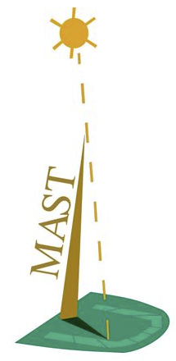
MAST
MAST is an open-source suite of tools that MAST offers an advanced set of schedulability analysis techniques optimized for single processor and distributed systems.

